Slide 1

ASM2MIF Compiler Design SOURINDU CHATTERJEE
ELECTRICAL AND COMPUTER ENGINEERING DEPARTMENT
FLORIDA STATE UNIVERSITY

Slide 2
INTRODUCTION
Tools : FLEX – A fast lexical analyzer
SCOMP Microprocessor Assembly and Architecture
Compiler Developments
Future Scope of Research
Questions

Slide 3

FLEX Overview
It is a software that makes scanner programs
The description are in the form of pairs of regular expressions and C code, called rules.
Flex generates as output a C source file, `lex.yy.c', which defines a routine `yylex()‘
This generates a scanner of .exe type which as linked with the `-lfl' library to produce an executable also the executable can be generated through the traditional gcc compiler. When the executable is run, it analyzes its input for occurrences of the regular expressions. Whenever it finds one, it executes the corresponding C code
Just simple yet complicated !!!!.

Slide 4
Different Aspect OF Development
FLEX
SCOMP Asm
Declarations
Definitions
Accumulator
Opcode
Rules
User Code
Variables
Compilers
Fast gcc or cc
Reliable
Upgrade
Reverse Compiler
Dynamic Correction

Slide 5
FLEX – Definitions Used
[\r\n]+|"\r\n"+
Newline
This is important because in Windows and Unix the line end characters are different. Thus it requires the specification for both systems.
"-"?[0-9]+
Digits
It can be negative as well as positive
[Ll][0-9]+[:]
Labels
It requires that it be distinguished from variables
[a-zA-Z][a-z0-9_]*
Variable Names
("0x"|"0X")[ABCDEF0-9]{1,4}
Hexadecimal Values
(?i:variable)
Case insensitive “variable”
It offers a special feature to enable or disable case sensitiveness, where ‘–i’ means case sensitive

Slide 6
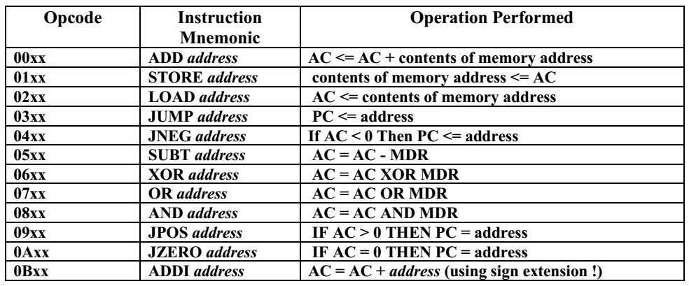
SCOMP Instruction Set
This is comprised of 16 bit : 8 bit Opcode + 8 bit Address
This is a special purpose Instruction Set with Von Neuman Architecture
It uses a single Accumulator (AC) which is the primary register used to perform data calculations and to hold temporary program data in the processor
MIF files has program instructions and initial data

Slide 7
Compiler Development
Scomp.asm -> (.l to .c to .exe) -> Scomp.MIF

Slide 8
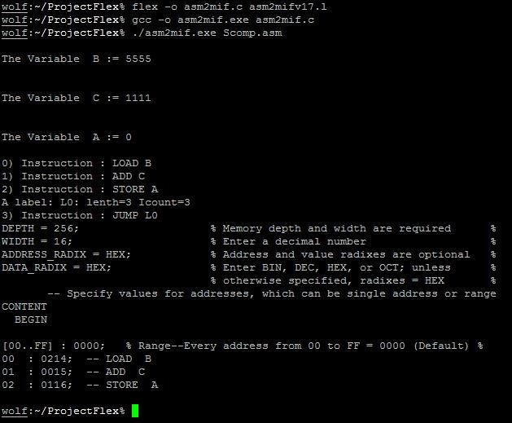
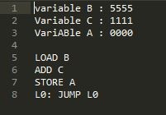
Basic Approach – asm2mifv17.l
Scomp.asm
Scomp.MIF

Slide 9
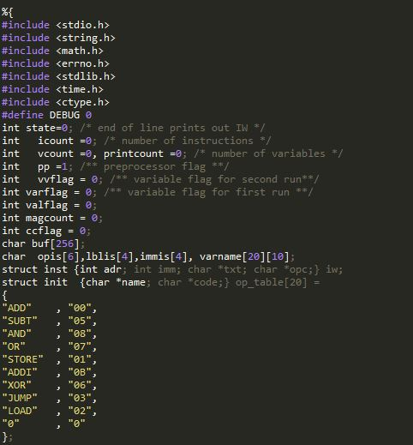
asm2mifv17.l

Slide 10
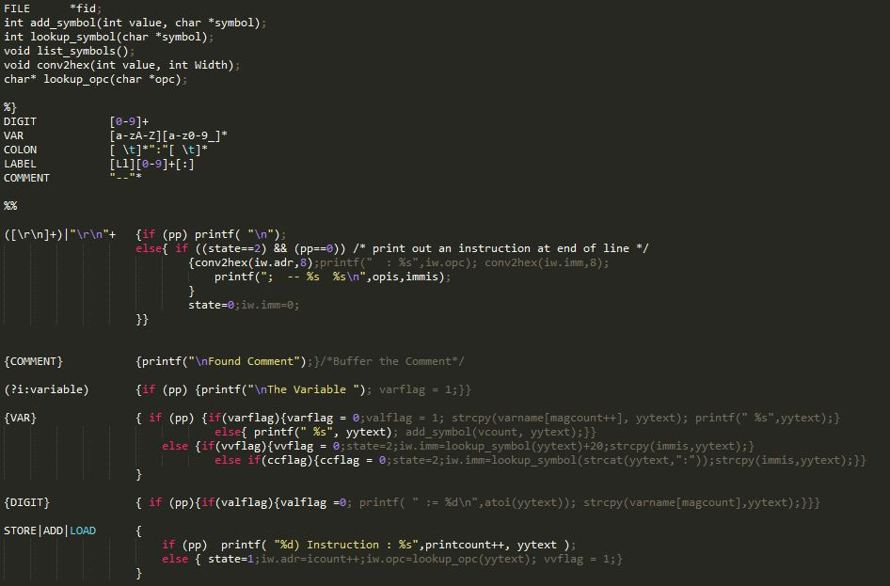
asm2mifv17.l

Slide 11
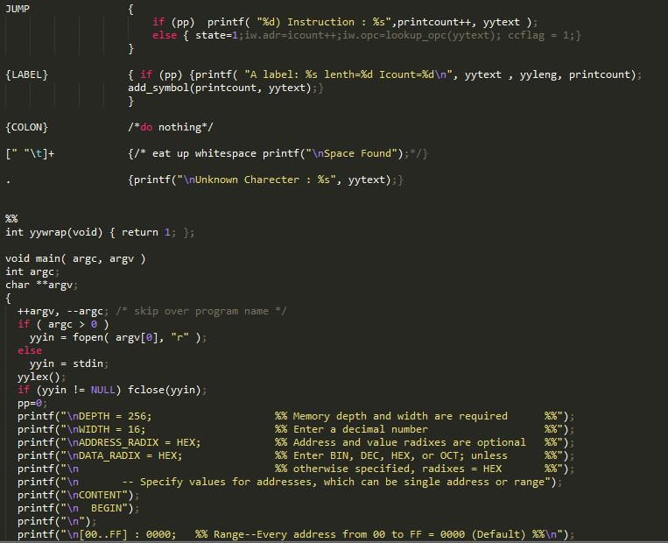
asm2mifv17.l

Slide 12
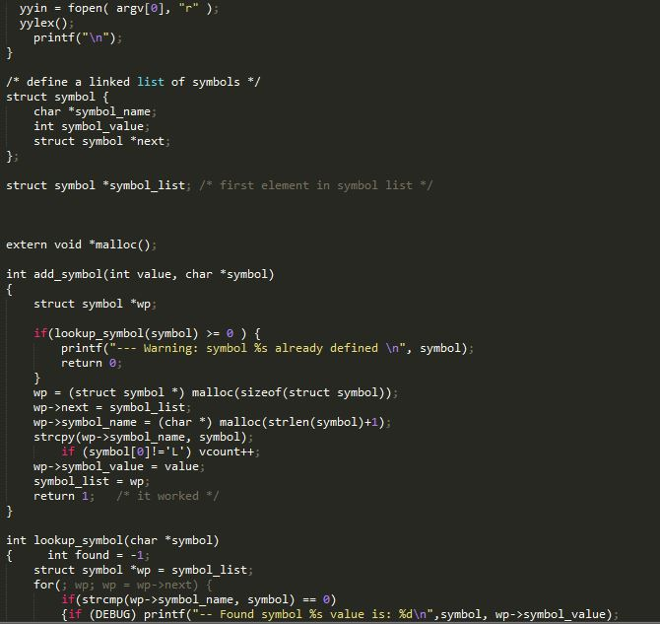
asm2mifv17.l

Slide 13
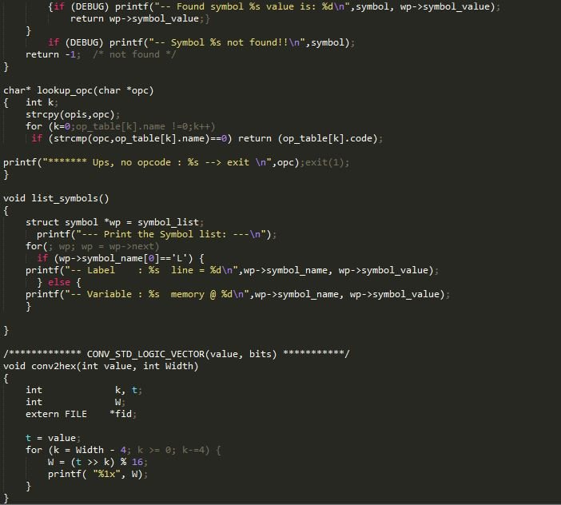
asm2mifv17.l

Slide 14
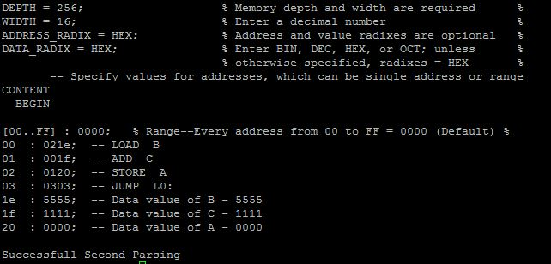
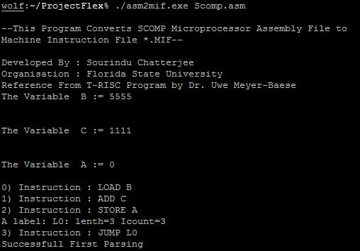
Variable Approach – asm2mifv20.l
Scomp.MIF

Slide 15
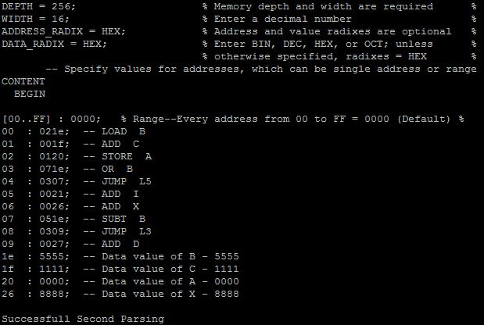
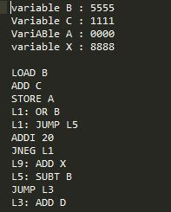
More Instruction – asm2mifv24.l
Scomp2.asm
Scomp.MIF

Slide 16
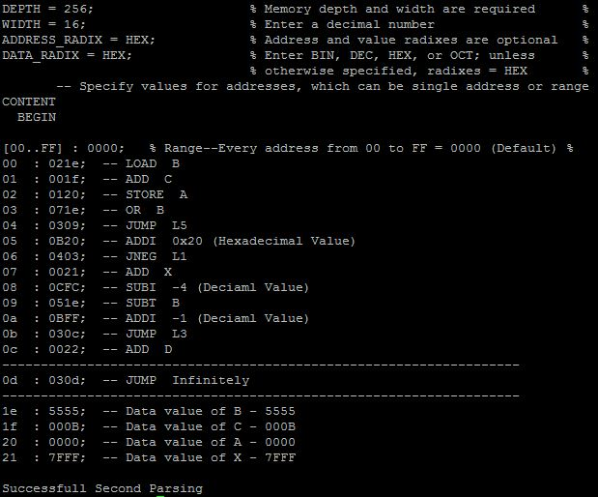
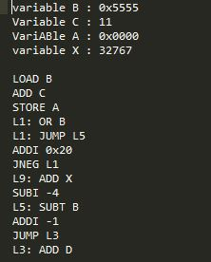
Finishing Touch – asm2mifv31.l
Scomp3.asm
Scomp.MIF

Slide 17
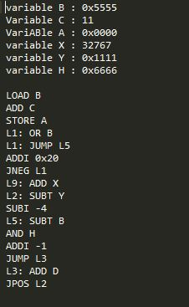
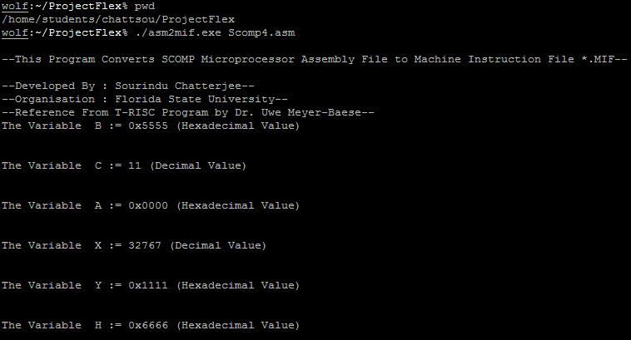
Output File – asm2mifv32.l
Scomp4.asm
Scomp.MIF

Slide 18
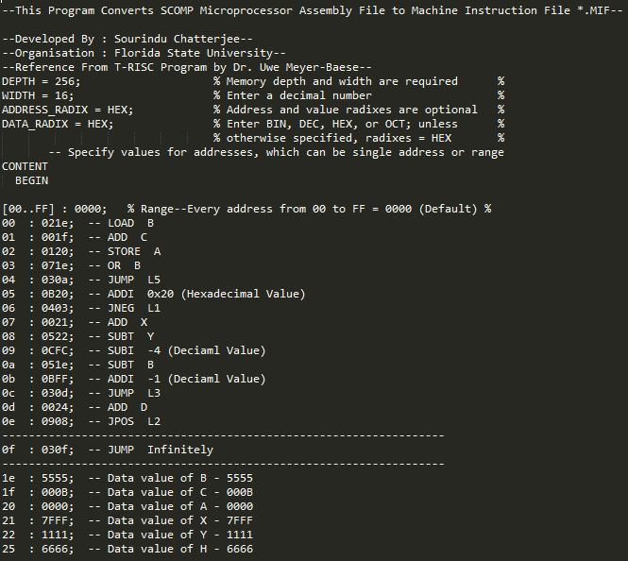
Scomp.MIF

Slide 19
DEMONSTRATION

Slide 20
Limitations & Future Prospective
Typically Complicated Programming requires enormous amount of time to code and debugging
Somewhat dependent on the bug free design of FLEX which is not available all the way until now.
A reverse compiler can be designed for .MIF to .asm
Error detection can be achieved like traditional gcc compiler
Error correction code can be made as this is human to human design

Slide 21


QUESTIONS

